Slide 1
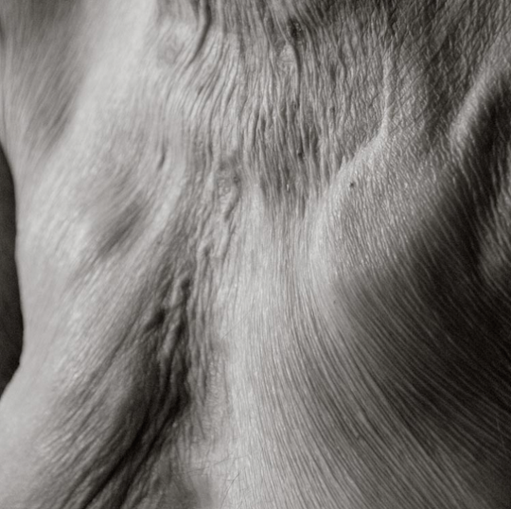
INTRODUCTION
Social perceptions and media representations of ageism
(VIP commercial)
Croatian context of old age population in local community
(Ivanić- grad)

Slide 2
Mid-term conference Ageing, Anti Ageing & Ageism: Constructions and Politics of Being Old in Europe
Active old age society and
local community development
Valentina Kanić – Ivana Brstilo
Klagenfurt, 18-20.9.2014.

Slide 3
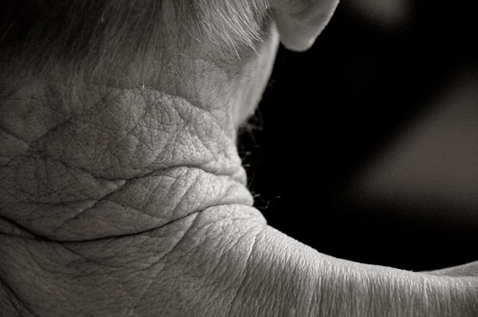
SOCIAL PERCEPTIONS OF AGED BODY
Antiquity
Modernity
Postmodernity

Slide 4
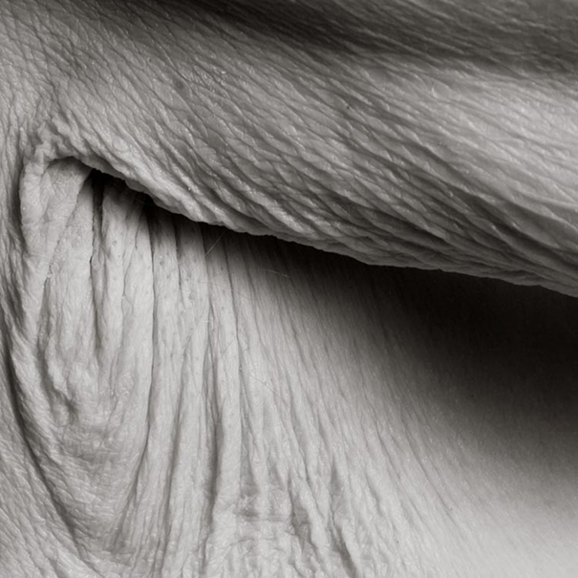
Late capitalism
Consumerist culture
Body as a machine
Body maintenance
Social regulation
Age (in)visibility

Slide 5
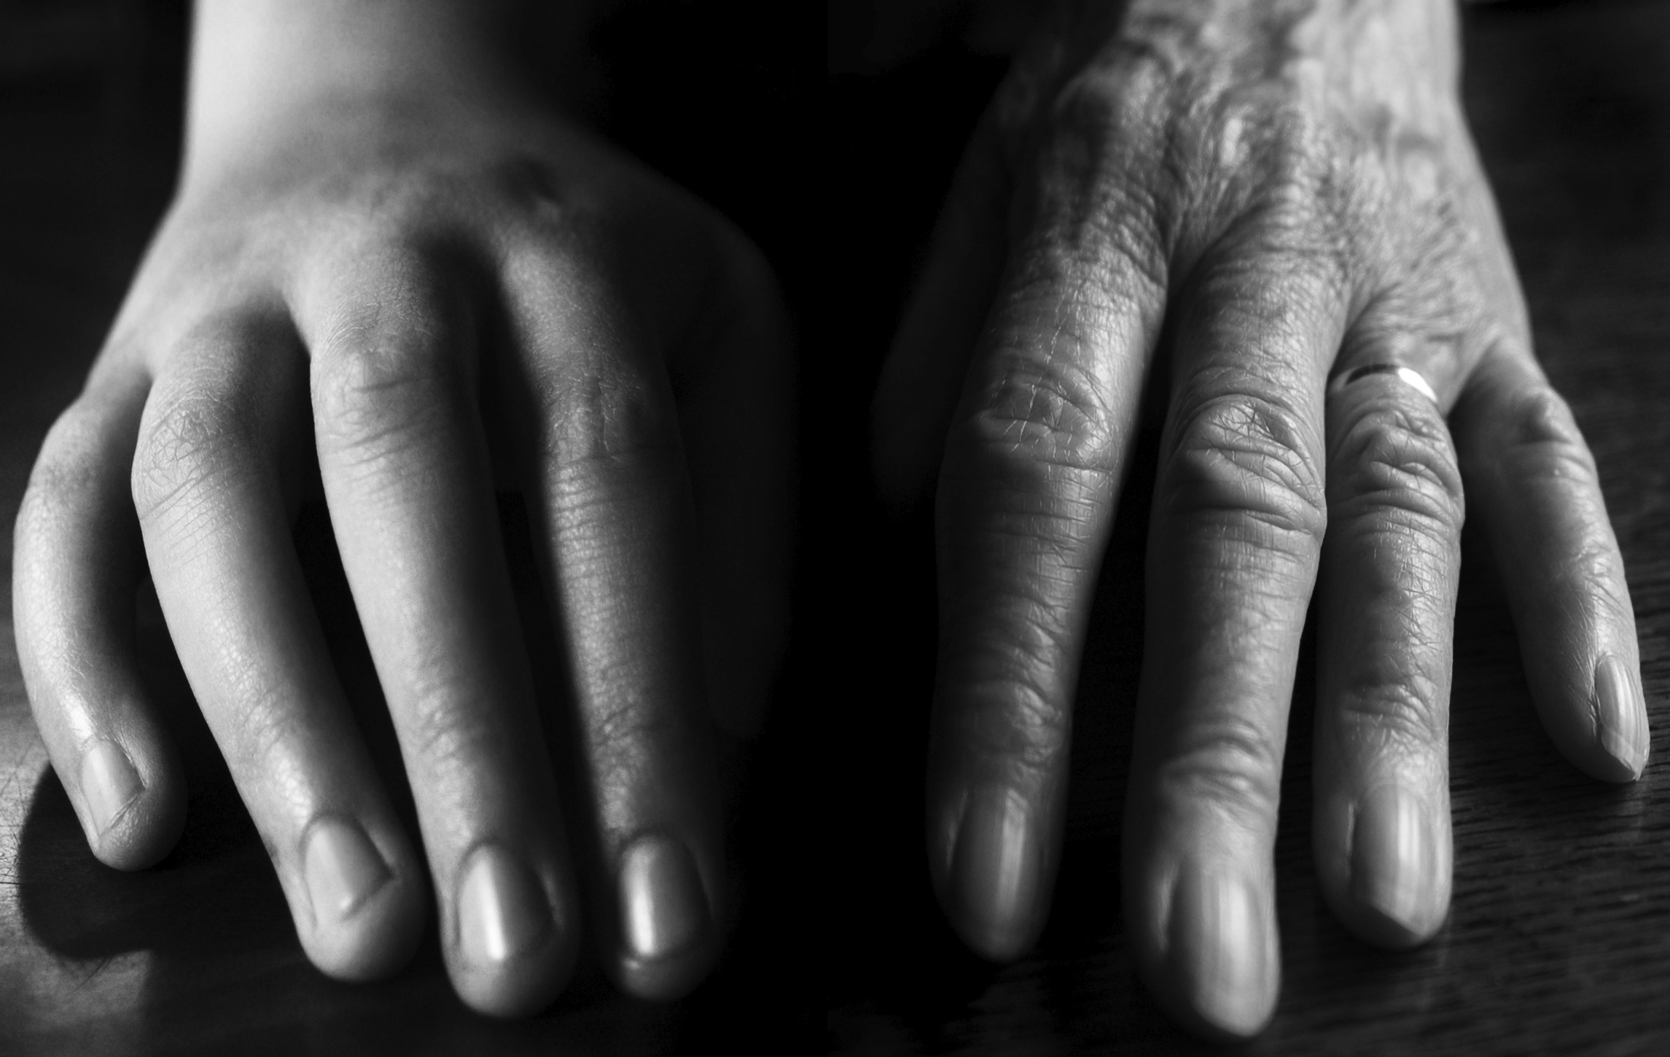
YOUNG - OLD
Media
Idea(l) of youth
Potential old-age consumers
Dichotomy
Social
perceptions
through media pictures

Slide 6
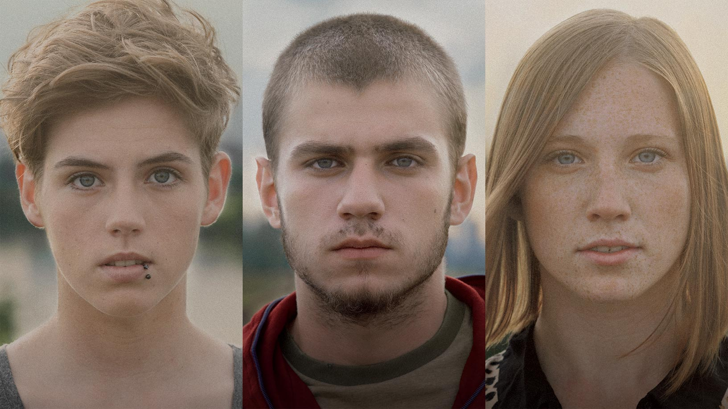
VIP COMMERCIAL

Slide 7
I KNOW WHY WE ANNOY YOU... BECAUSE WE ARE YOUNG AND YOU ARE NOT! SORRY, BUT SOMEONE SHOULD HAVE TOLD YOU THAT.
We don't have a plan, like you had one?
We are lazy and awful.
They say that we will ruin the whole world. Whole world.
We will live forever with our parents,
and we will never grow up.
According to you, we are all "lame". And you don't even know what lame means.
Just google something already.
We are awful, illiterate and don't stand up to older people. Because like we type too much.

Slide 8
Ivanić-Grad (John’s City)

Slide 9
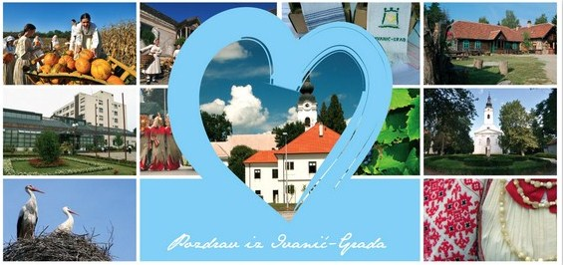
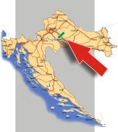
40 km south-east from Zagreb
173,57 km²
9 379 inhabitants (14.548 surroundings)
3 196 inhabitants aged 60 and over (34%)
(age coefficient 22; Croatia 24,1)

Slide 10
Posssibilities
City’s pensioners’ and
citizens’ association
„Third Age”
City’s pensioners’ association
Ivanić-Grad

Slide 11
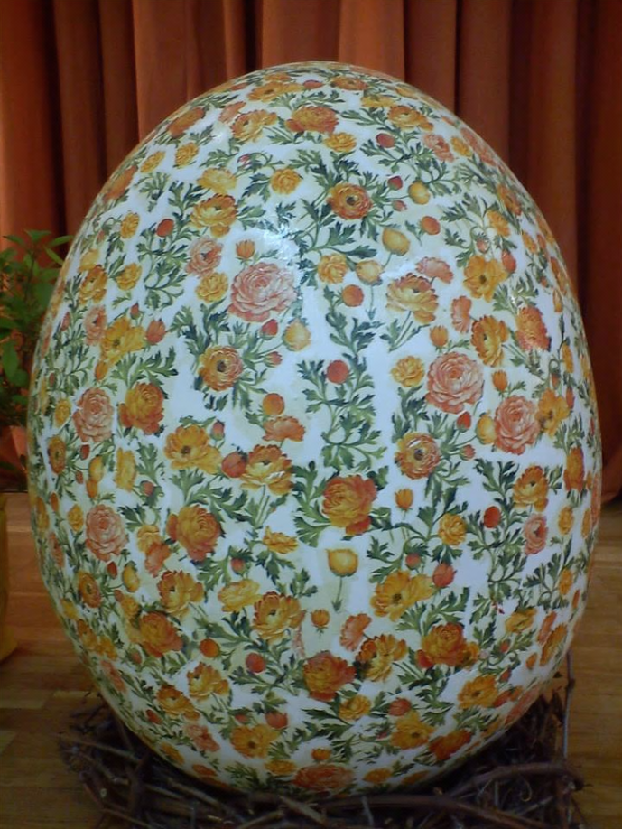
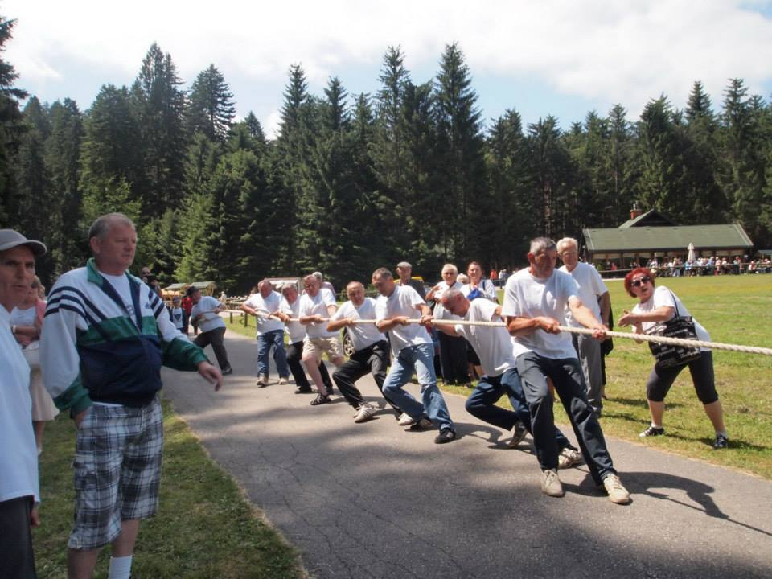
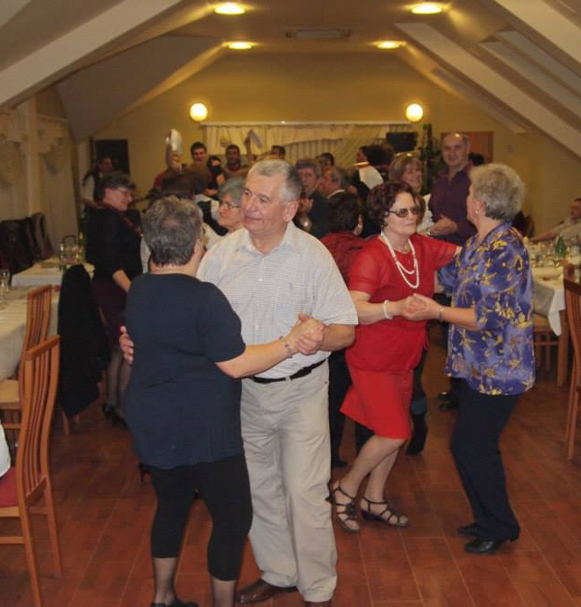
Citiy’s pensioners’ and citizens’ association „Third Age”

Slide 12
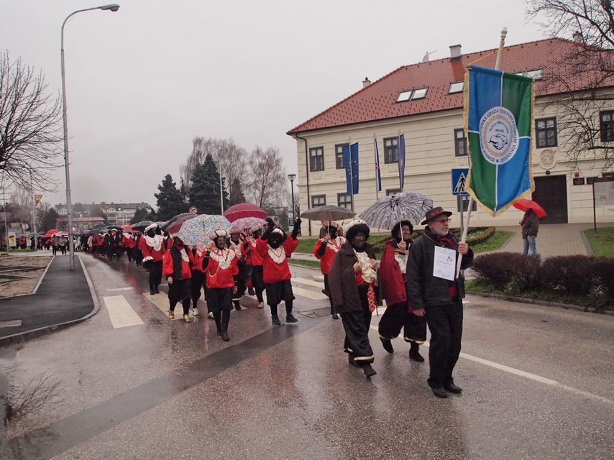
Active citizens

Slide 13
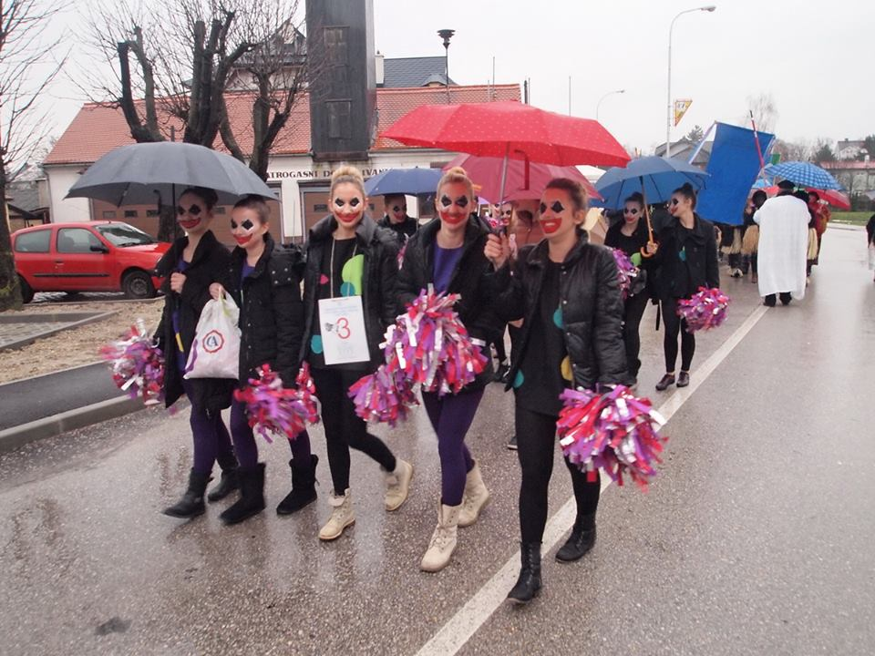
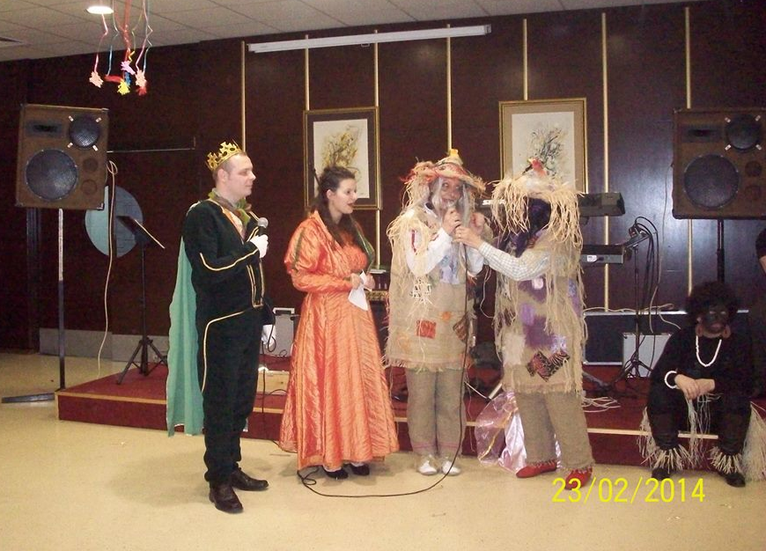
https://www.facebook.com/groups/3dobIG/

Slide 14
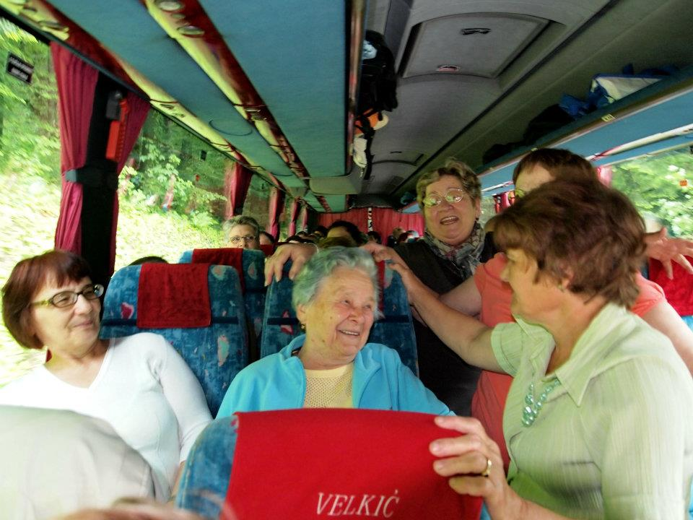
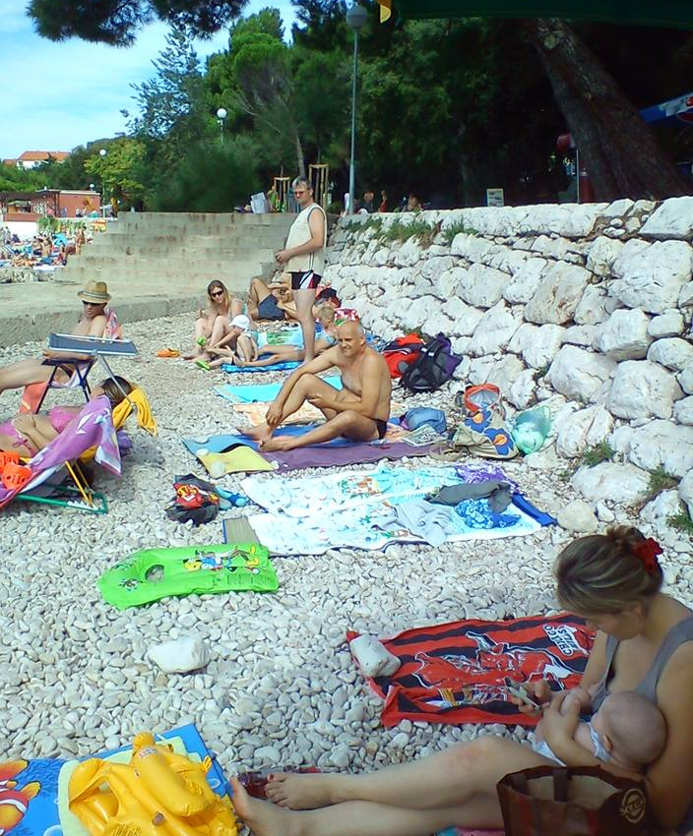
„To the seaside with retrees”
https://www.facebook.com/groups/3dobIG/

Slide 15
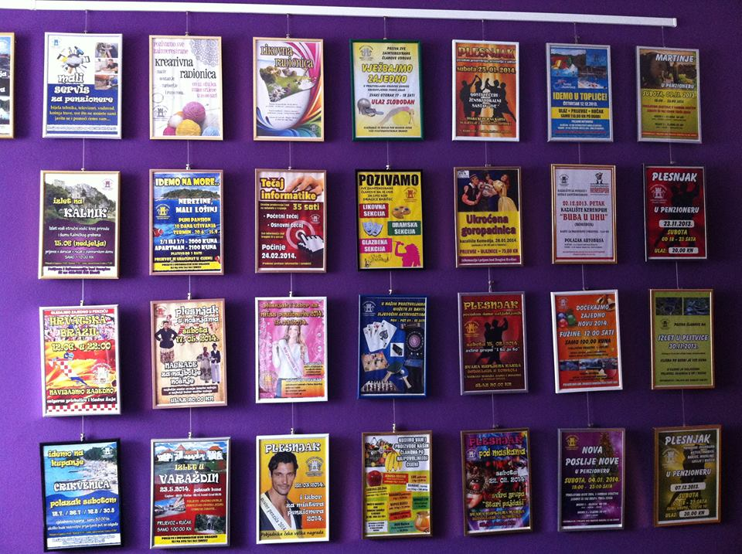
Cities pensioners’ assotiation
Ivanić-Grad

Slide 16
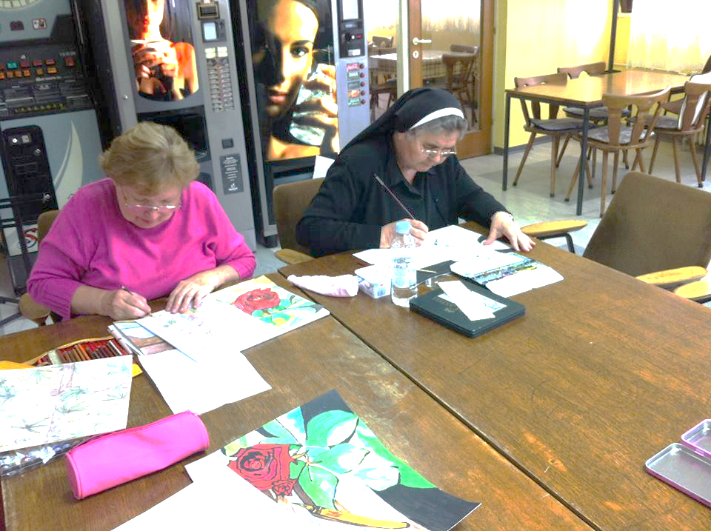

Slide 17
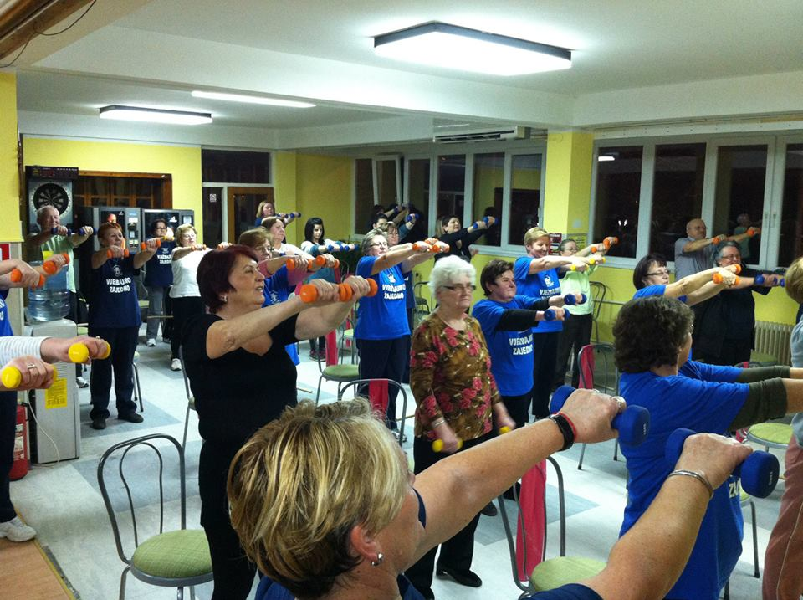

Slide 18
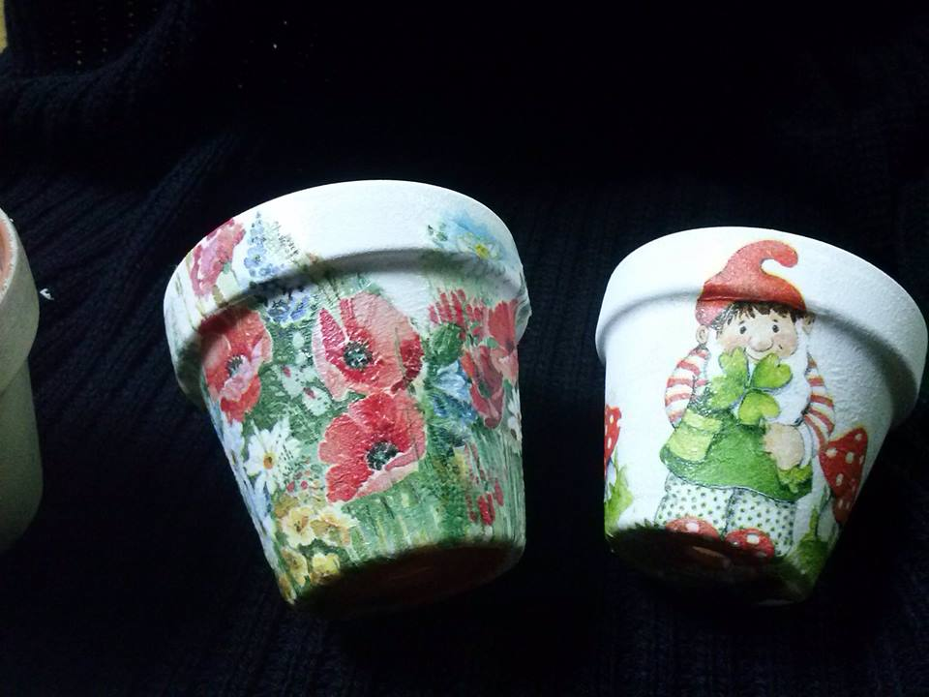

Slide 19
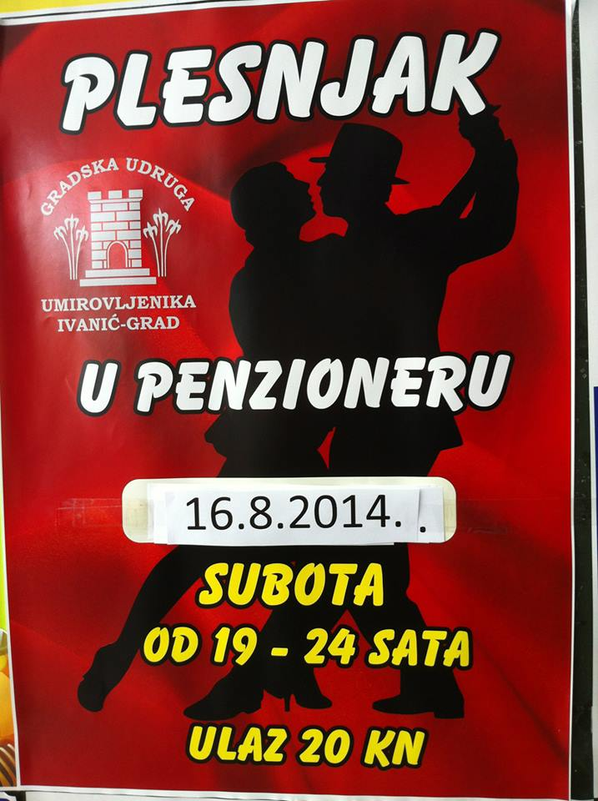

Slide 20
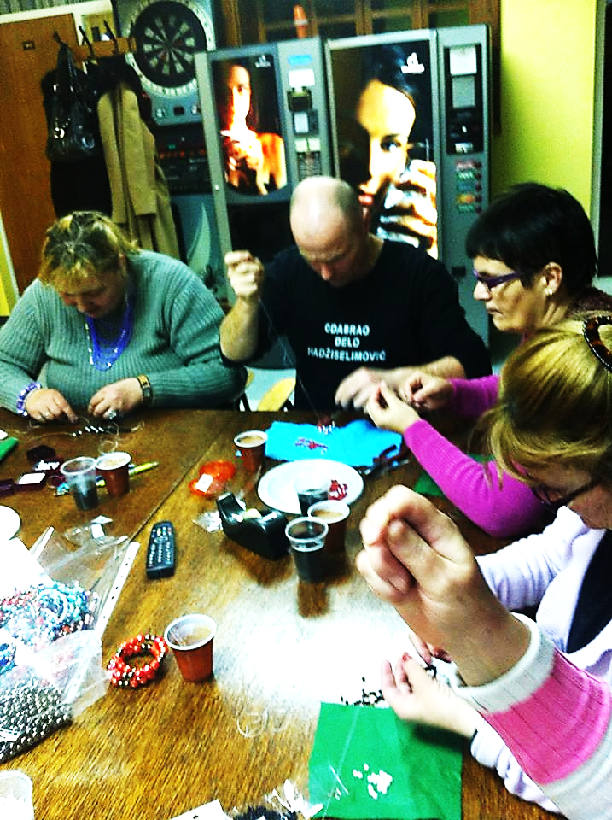
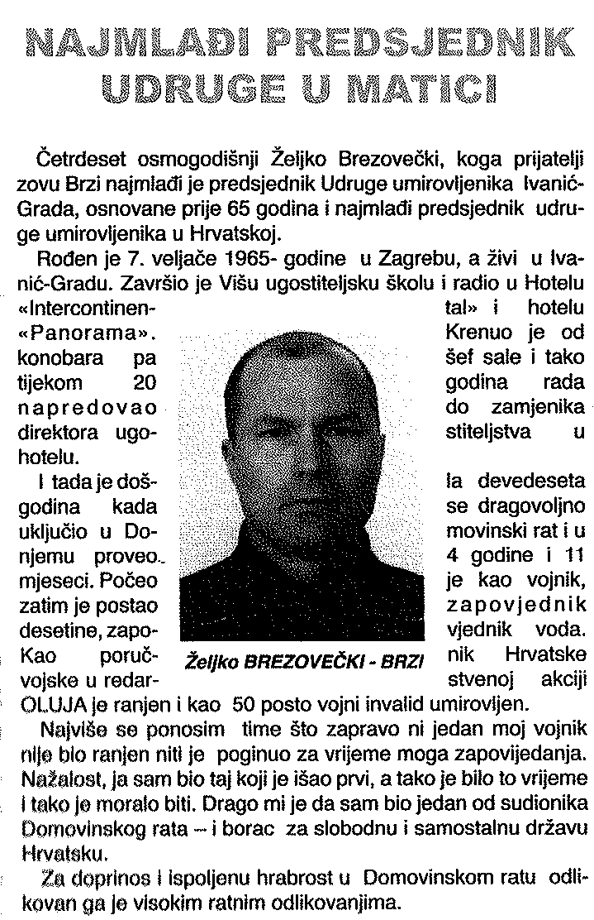
The youngest president of all pensioners assotiations in Cro

Slide 21
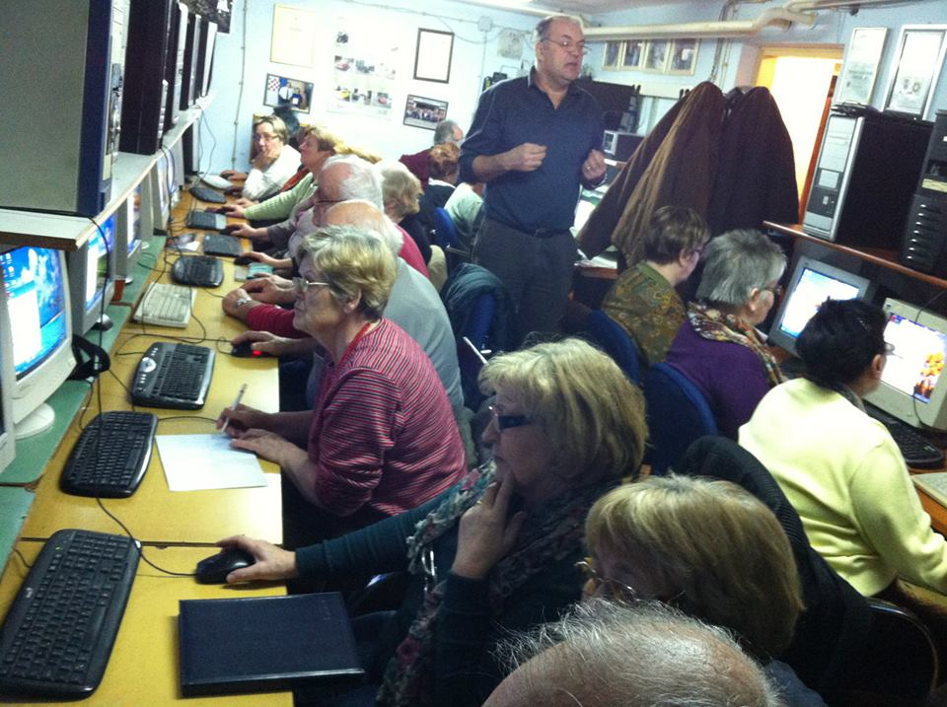
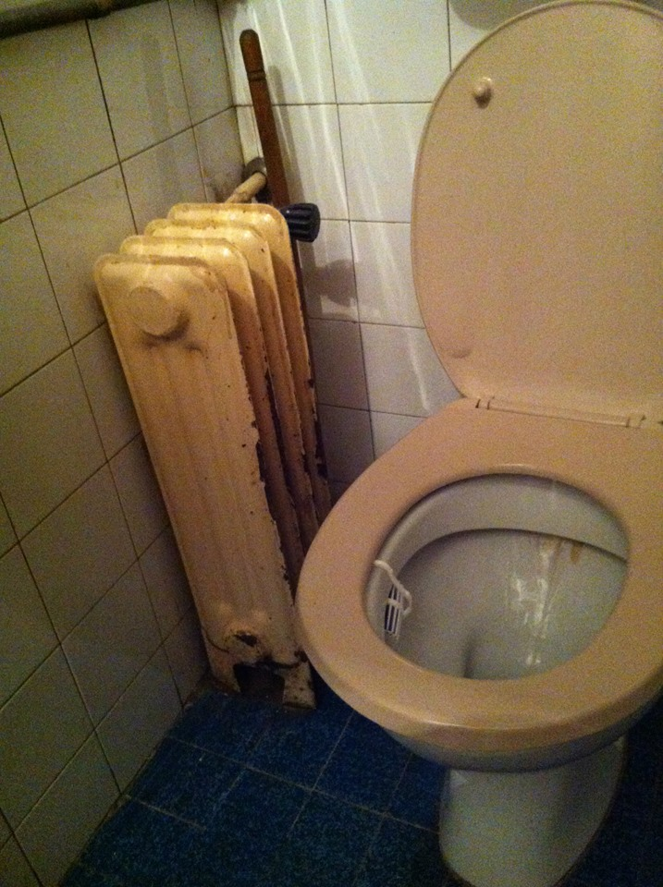
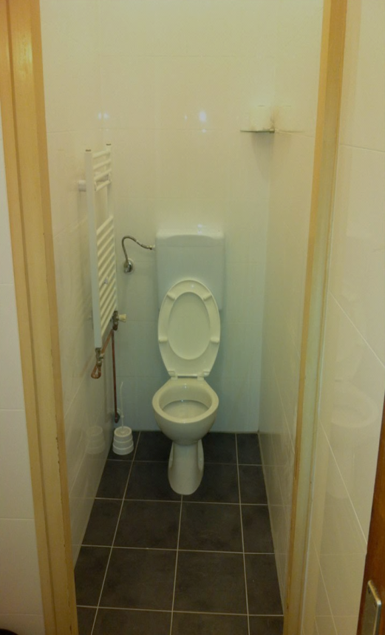

Slide 22
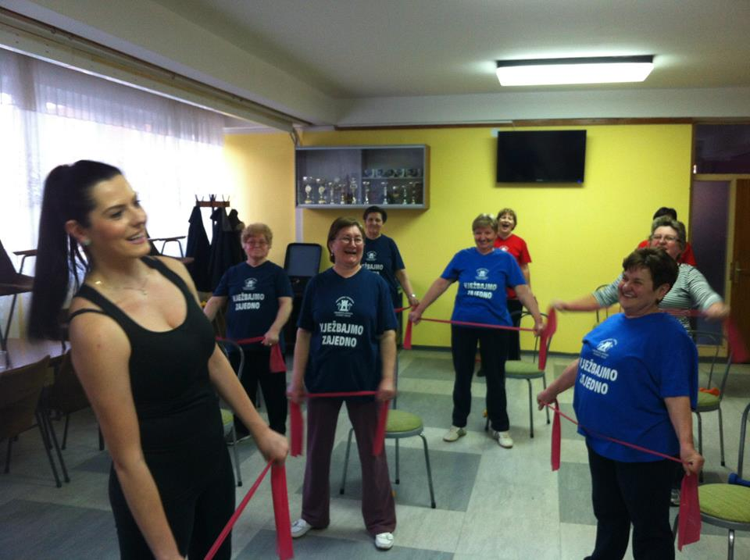
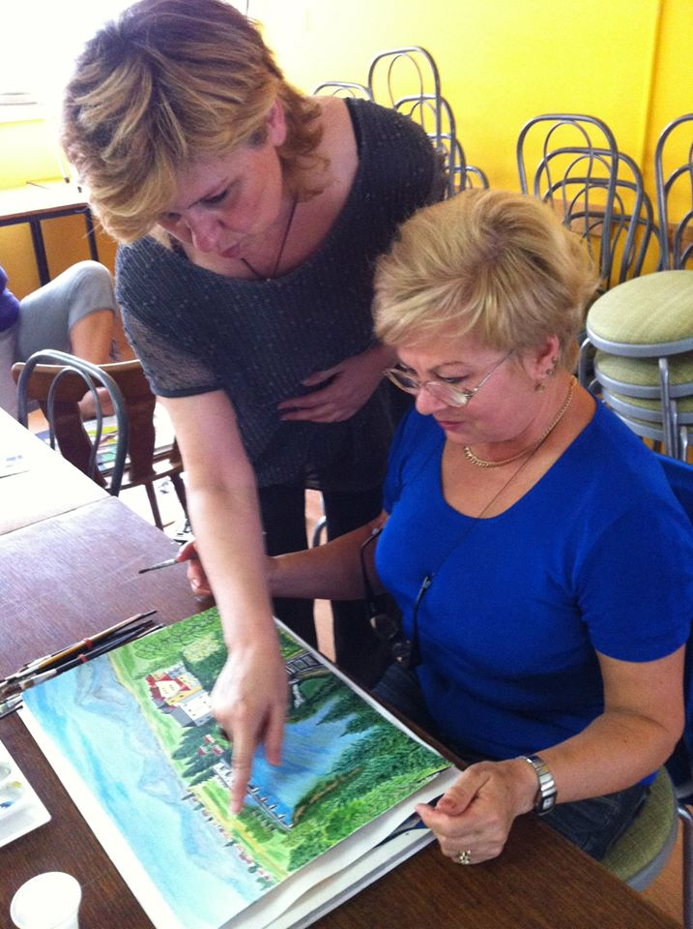
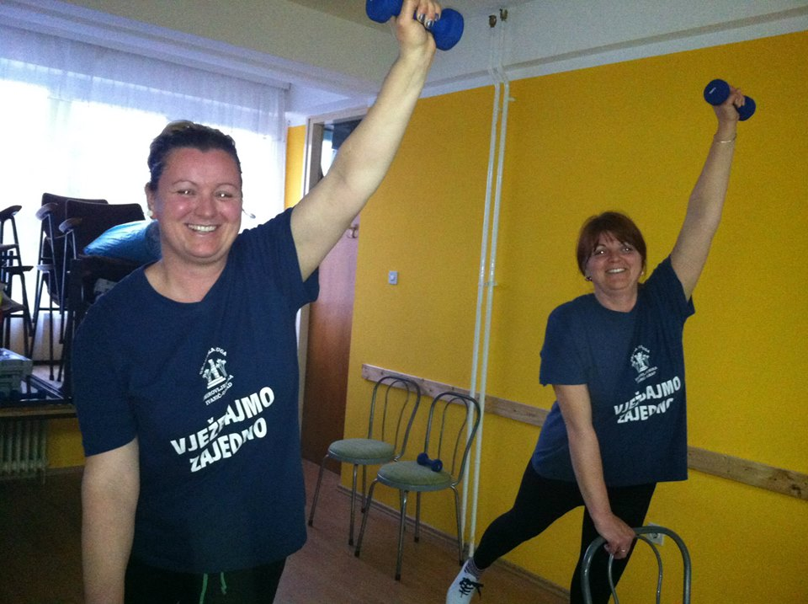

Slide 23
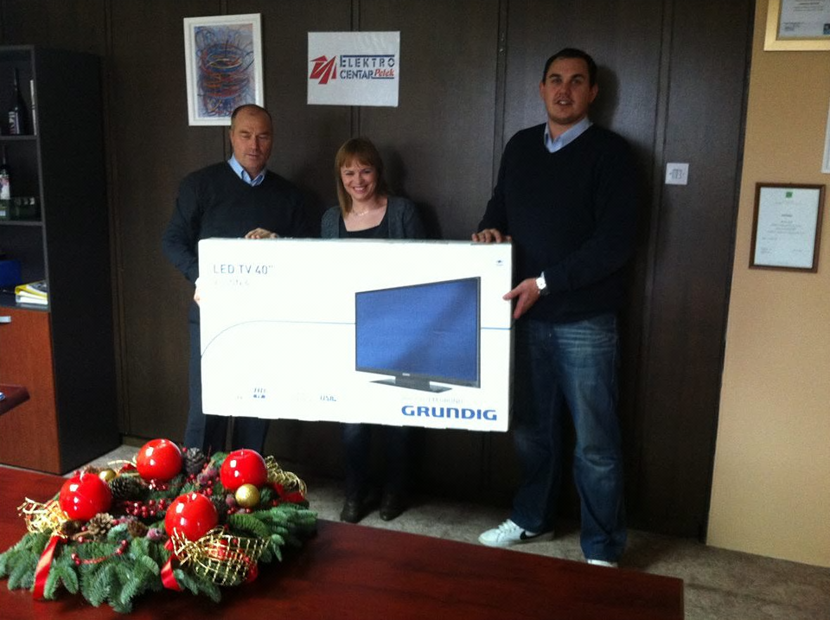

Slide 24
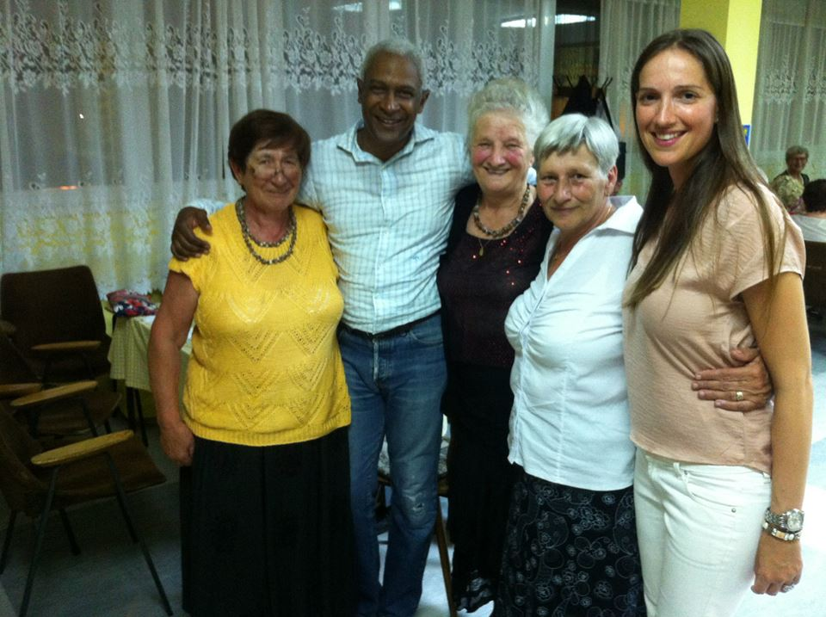
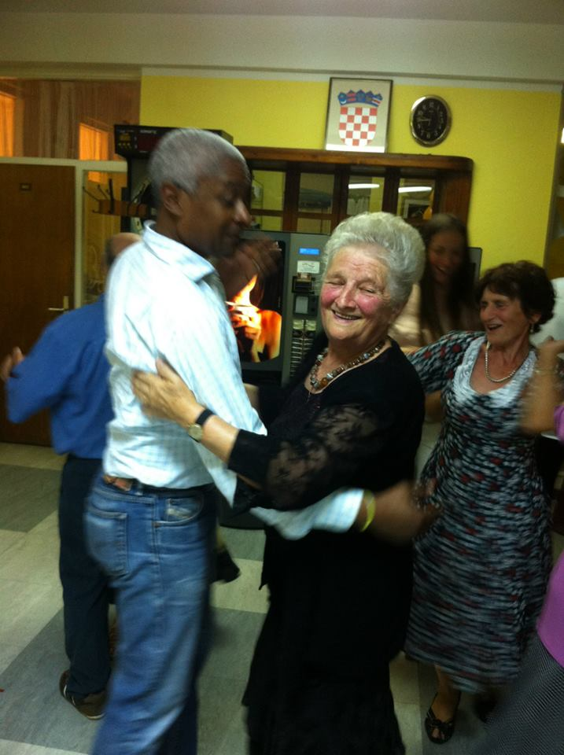

Slide 25
2012 Vienna Ministerial Declaration Ensuring a society for all ages: Promoting quality of life and active ageing
Promoting and strengthening multigenerational dialogue and intergenerational learning by all stakeholders, including governments, non-governmental organisations, the private sector, the media and the general public.
Combating ageism through awareness campaigns and by encouraging the media and other opinion-making actors to give an age-balanced image of society, highlight the positive aspects of ageing, develop non-discriminatory images of older persons, and disseminate information about ageing as a natural phase in individual development.
Recognizing the value of and fostering the joint volunteering of people of all ages.

Slide 26
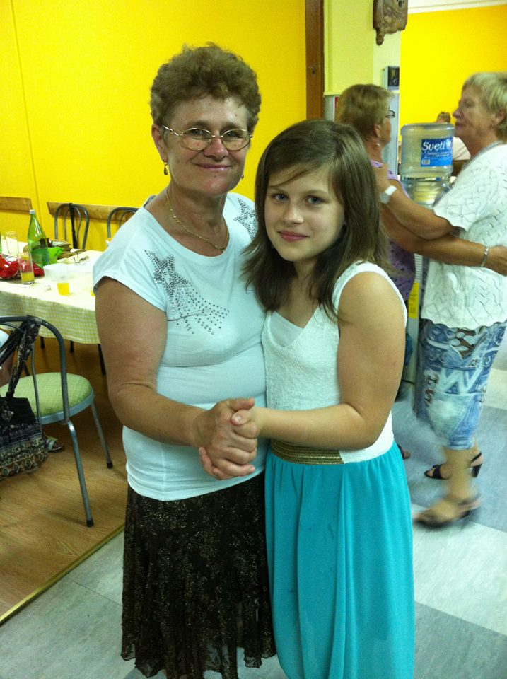
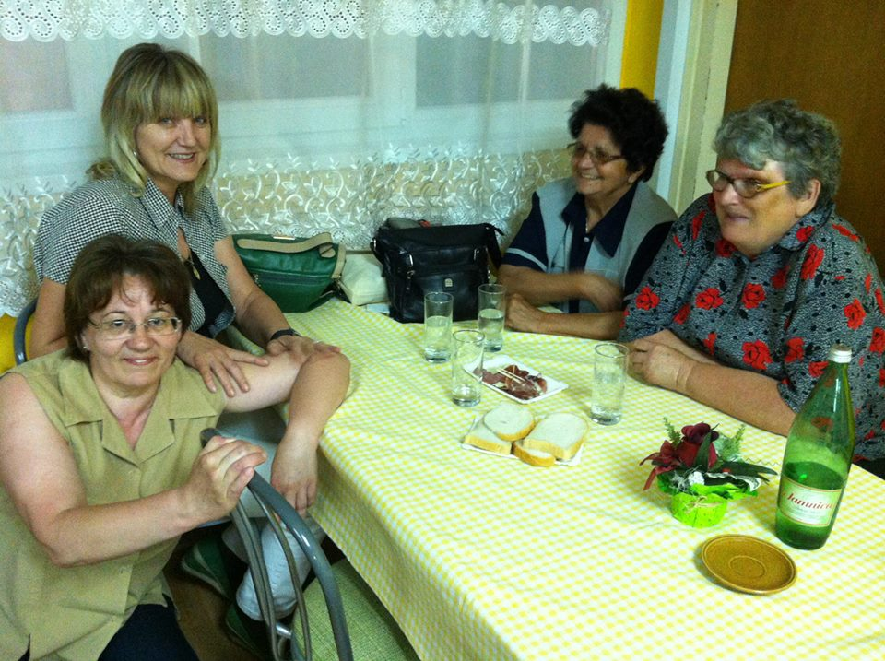
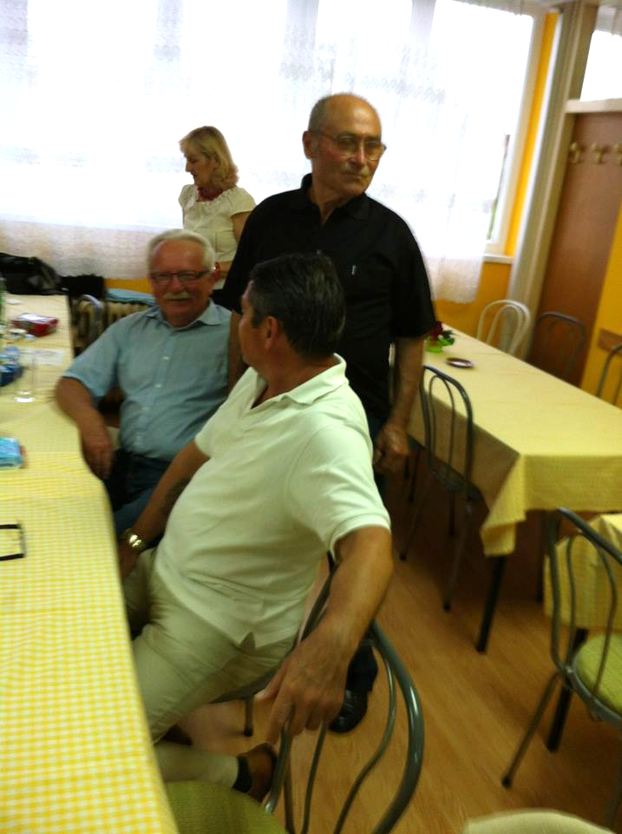
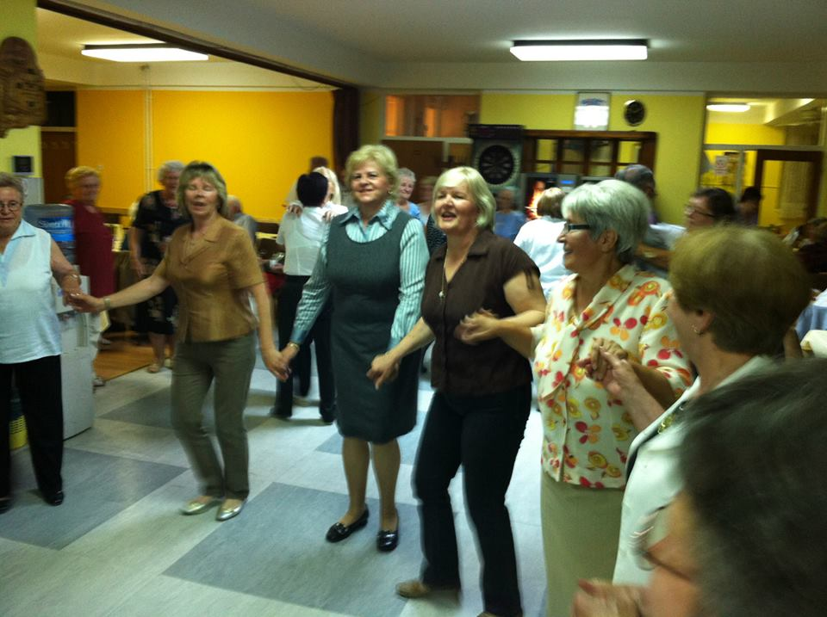
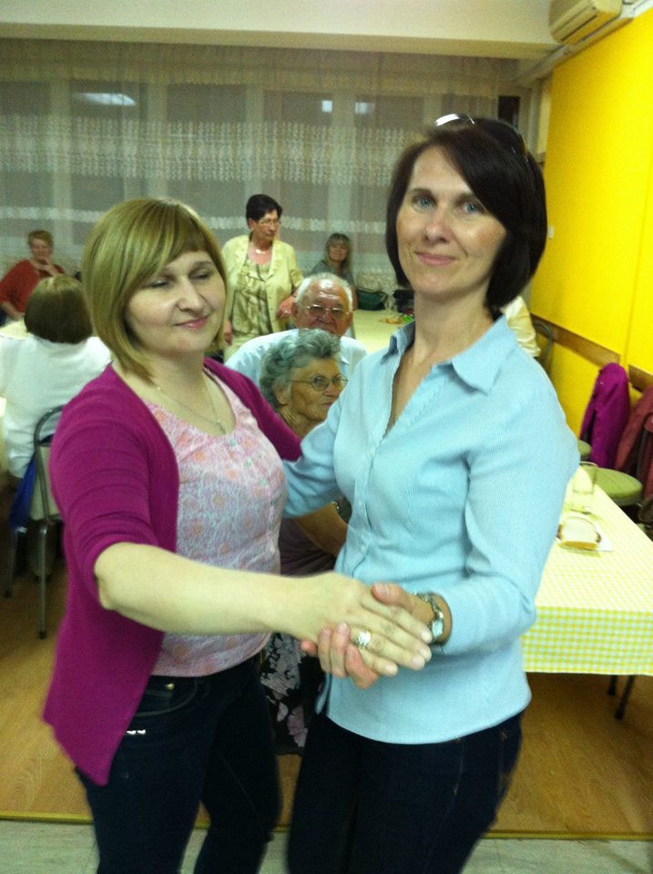

Slide 27
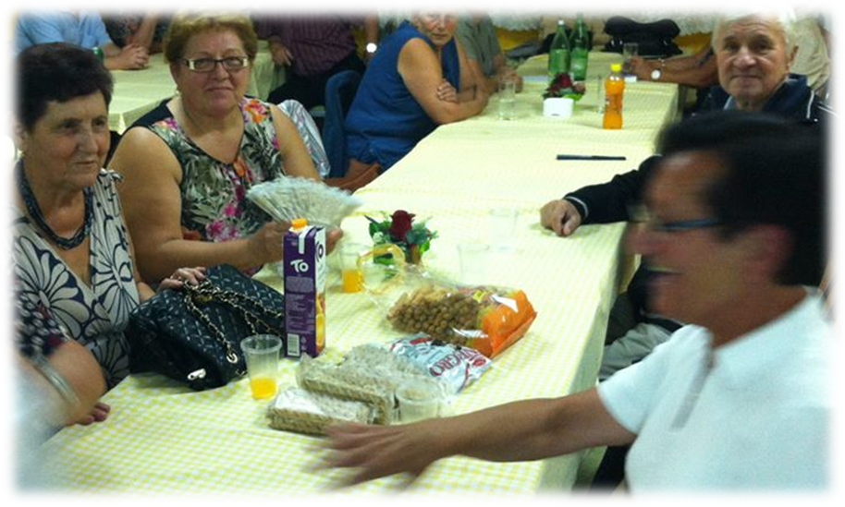
Empowering people to realize their potential for physical, mental and social wellbeing throughout the life course and to fully participate in society according to their needs, desires and capacities.
2012 Vienna Ministerial Declaration
Subsidiarity
Transfer of knowledge and tradition
Modesty and moderation

Slide 28
"It is unfortunate that many of today's young people consider pensioners as a burden, but they have, it is forgotten, generously invested in everything that we have today while they were working. For several years these people – who are working now - will come in our position and will be retired. The message is for them – not to forget – time is fleeting, and you'll come to ours. We all together must be sensitive to that category; because it primarily deserves a kind word - we need to listen to seniors well. True, they can no longer run 100 meters with us to, can not lift the load, but they can give us his vast knowledge and rich experience so that we can more easily overcome the present distress. „
Croatian pensioners sheet, February 2014th
Sorry, somebody should told you...

Slide 29
THANK YOU FOR YOUR ATTENTION !

